Slide 1
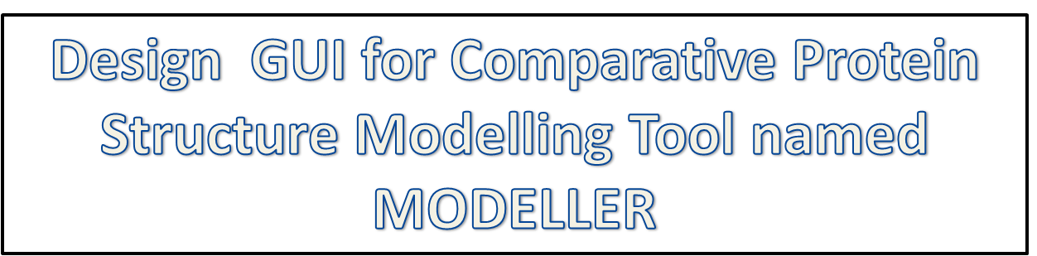
Presented By:-
Navjeet Kumar
BE/1012/06
Abhinav Mathur
BE/1016/06
(under the supervision of Dr. A.S. Vidyarthi)

Slide 2
INTRODUCTION
MODELLER is a bioinformatics tool for comparative protein structure modeling
Aim – Building of a 3D model of target protein sequence (unknown) based on related proteins of template structure (known).
Use – Information about structure and functions of the unknown protein

Slide 3
CHARACTERISTICS OF MODELLER
Controlled by command line
Script is written in PYTHON language
No GUI
INPUT:
Target Sequence (ALI Format)
Template Structure (PDB Format)
Python Script
OUTPUT:
Target template Alignment
Model in PDB Format
DOPE score plot

Slide 4
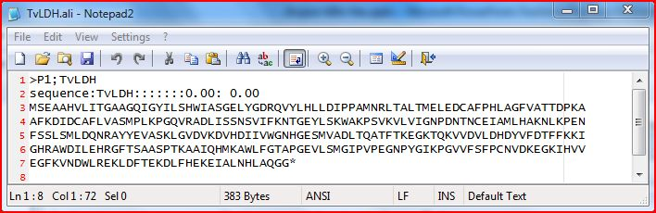
NEED FOR GUI
Formatting of target sequence into a MODELLER recognizable format

Slide 5
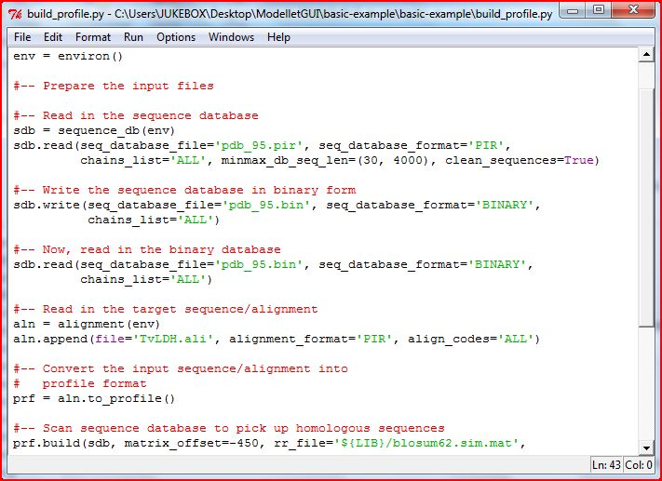
Python script for searching the PDB database for templates

Slide 6
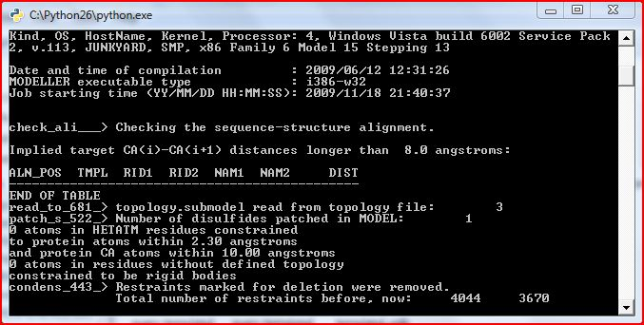
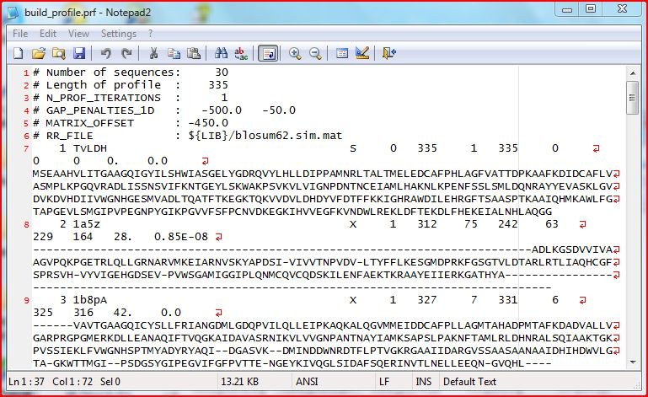
Executing of Python script in
command prompt
Output after the execution of Python script

Slide 7
Objectives
To design an interactive Graphic User Interface (GUI) for MODELLER (Comparative Structure Modelling Tool), command line argument based tool.
To ease the use of software by eliminating cumbersome formatting of the inputs, scripting processes and analysis of verbose output files.
To give the software a wider range of users by giving, pasting of the target sequence as the only prerequisite. Thus lowering of the skill level required to use this software.

Slide 8
Methods
Sequence Input
Database Search for Templates
Upload Templates
Template (s) Selection
Use of Multiple Templates
Use of Single Templates
Comparison of Templates
Target-Template Alignment
Selection of Models
Evaluation Graph
Draw Structure

Slide 9
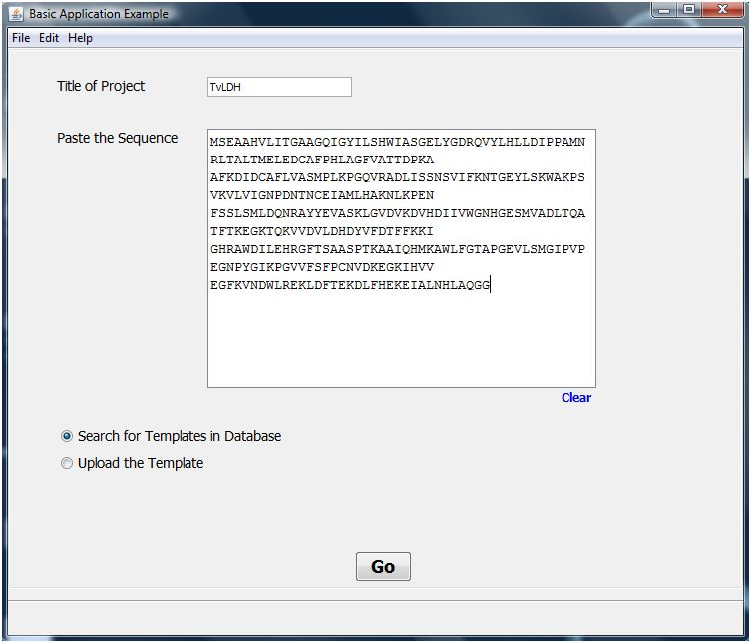
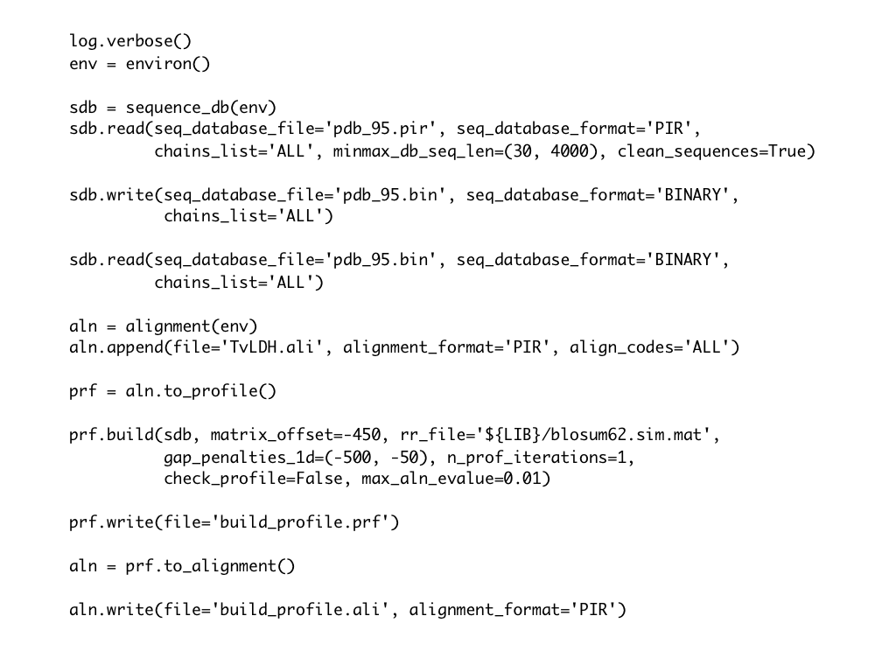
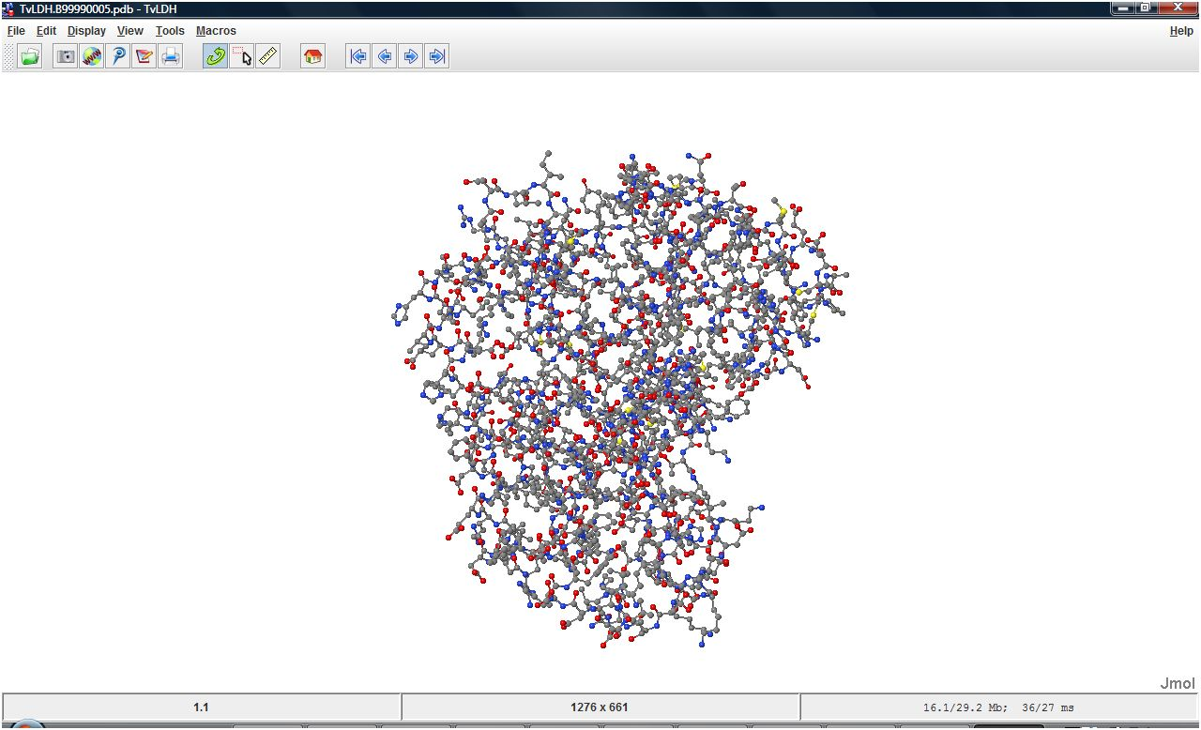
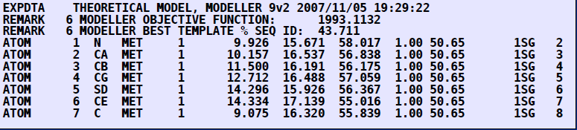
Results and Discussion
Input :- Python Script
Output PDB file

Slide 10

Results and Discussion
S.No. | Activity | Time taken by the MODELLER procedure | Time taken by the GUI procedure
1. | Save target sequence in .ali format | 1 min
2. | Identify, Select and Download homologous structures using BLAST search | 7 min 30 sec
3. | Opening compare.py and editing the template codes and chains | 3 min
4. | Executing compare.py script using MODELLER | 10 sec
5. | Opening compare.log, finding the required data, analyzing the dendrogram and consequently editing template code in align2d.py | 5 min
6. | Executing the align2d.py script using MODELLER | 1 min 20 sec
7. | Opening the .pap file and analyzing the target-template alignment. Making the required modifications in model-single.py | 5 min
8. | Executing the model-single.py using MODELLER | 8 min 35 sec (for 5 models)
9. | Opening model-single.log and analyzing the assessment score table at the end of the file for DOPE and GA341 score. Also, selecting models based on these scores and editing the python files required for plotting the evaluation graph (evaluate_model.py, evaluate_template.py, plot_profiles.py) | 11 min
10. | Executing the above mentioned python files using MODELLER | 40 sec
11. | Viewing the evaluation graph kept in the working directory | 2 min
12. | Opening the model.pdb file with a visualising software like Jmol | 1 min
Total Time Taken |  | 46 min 15 sec | 18 min 15 sec

Slide 11
Conclusion
The features of the application developed in this work :
Used for easy homology modelling without any knowledge of scripting and pasting of sequence is the only prerequisite.
Has every step automated, interactively guided and gives complete information of the backend process as well.
The models can be easily evaluated and their energy can be viewed by automated plotting feature.
The application reduces the time consumed in writing scripts and formatting inputs
Thus the application provides a one place solution to all the homology modelling needs.

Slide 12
References
Narayanan Eswar, David Eramian, Ben Webb, Min-Yi Shen and Andrej Sali, Protein Structure Modeling With MODELLER, Current Protocols in Bioinformatics 5.6.1-5.6.30
John Wiley & Sons, Inc., (2006)
Roberto Sanchez and Andrej Sali, Comparative Protein Structure Modeling, Methods in Molecular Biology, vol. 143, Humana Press Inc., (2000)
Mark A.Marti-Renom, Comparative Protein Structure Prediction- MODELLER Tutorial, Prince Felipe Research Center (CIPF),Valencia,Spain
Andrej Sali and Tom L.Blundell, (2003) Comparative Protein Structure Modelling by Satisfaction of spatial restraints, Journal of Molecular Biology, vol. 234, p 779-815
M.S. Madhusudhan, Benjamin M. Webb, Marc A. Marti-Renom, Narayanan Eswar and Andrej Sali, Alignment of multiple protein structures based on sequence and structure features, Protein Engineering, Design & Selection pp. 1–6, (2009)

Slide 13


